Slide 1


Timeline
First steps
Final presentation
Local threshold
Otsu and Dice
10.05.
31.05.
14.06.
Buffer and report
28.06.
21.06.
17.05.
07.06.
Cell counting
Multithresholding
Project proposal
Preprocessing and testing

Slide 2

Median filter
3 Dataset
gaussian filter
Otsu‘s thresholding
Histogram stretching
Preprocessing
Two level Otsu
Local adaptive thresholding average
Two level Otsu clip
Local adaptive thresholding count
Dice Score
Our optimal thresholded image

Slide 3
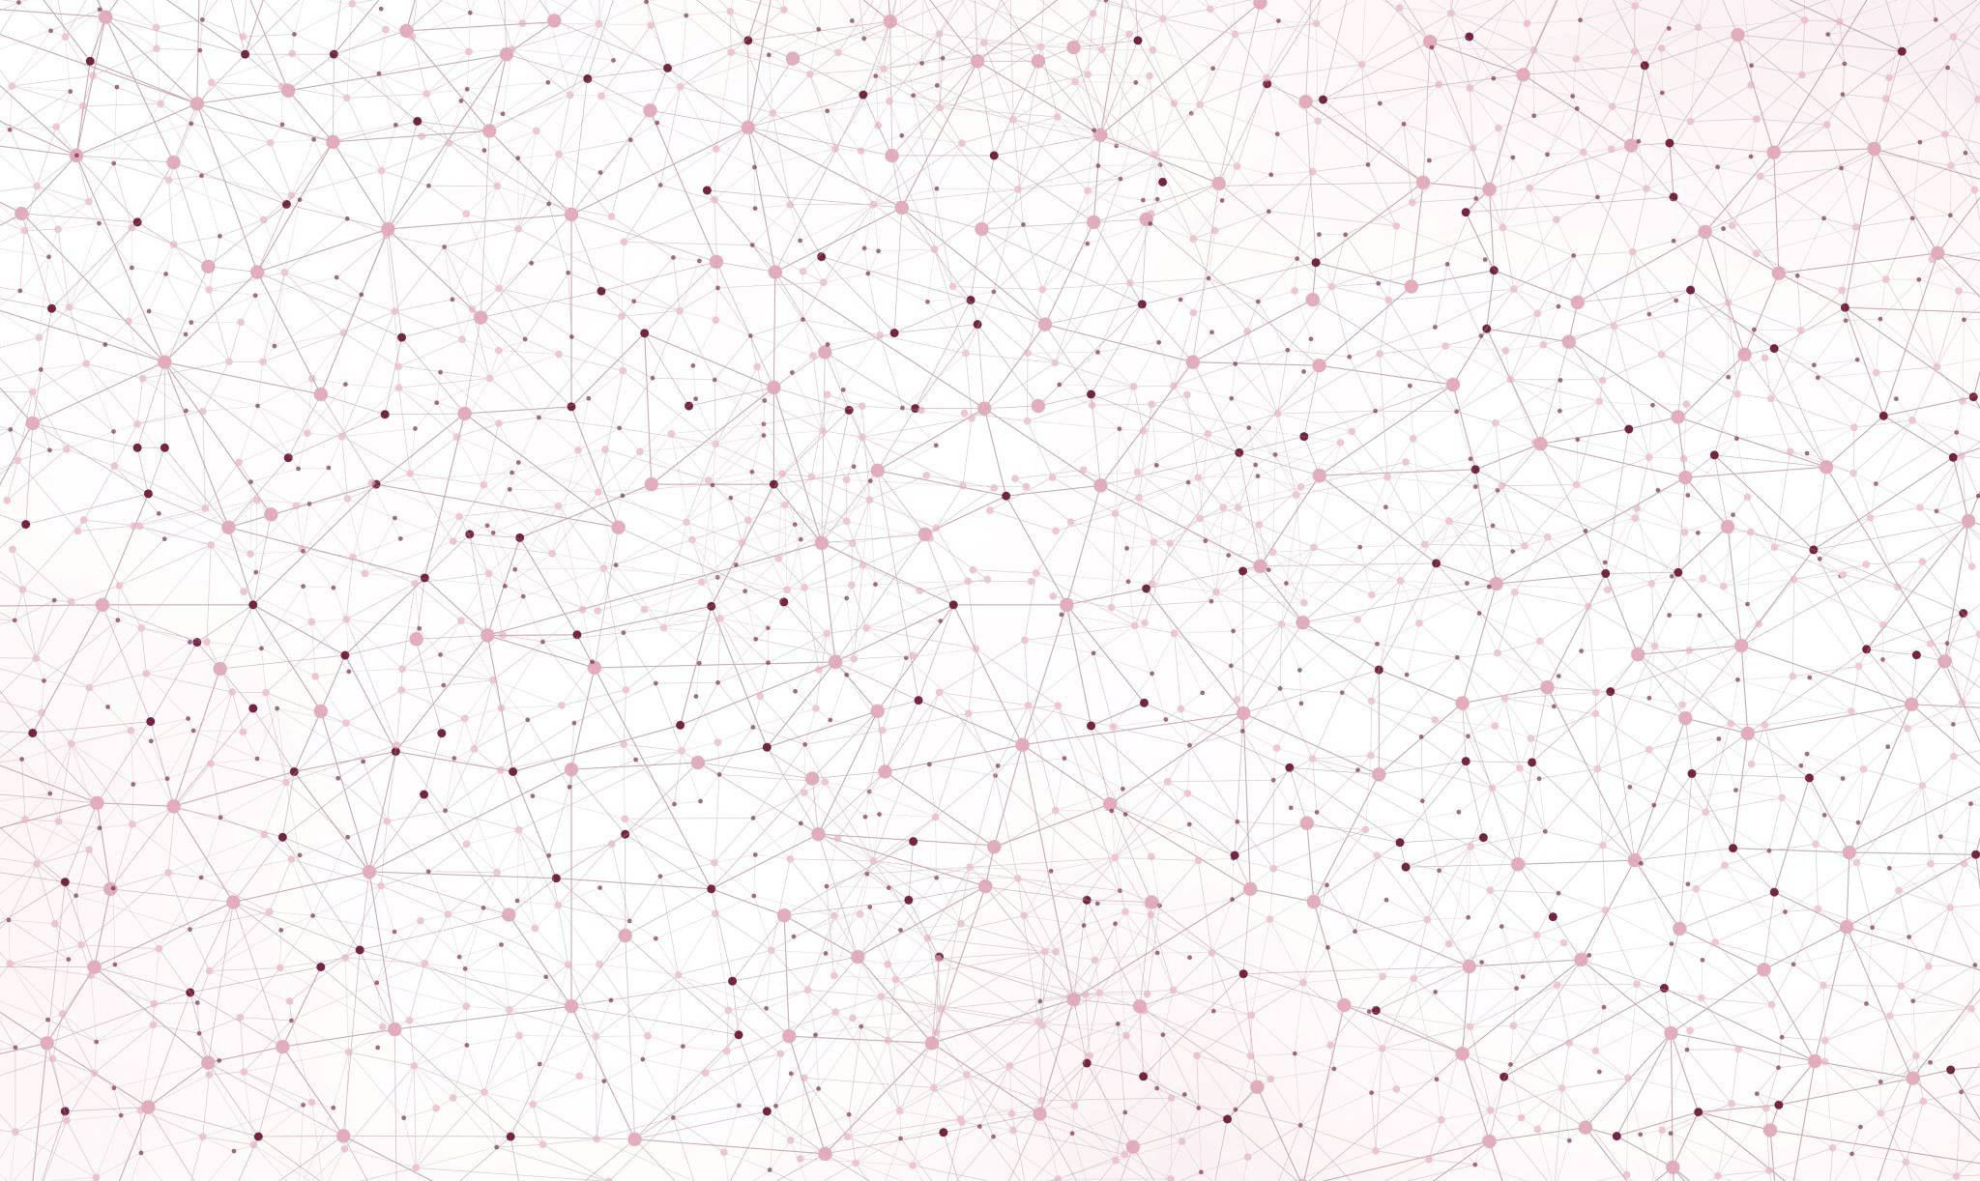
Cell Nuclei Segmentation
Implementation and Evaluation
of Otsu Thresholding
Final presentation
Topic 01: Biomedical Image Analysis
Supervisor: PD Dr. Karl Rohr, Christian Ritter, Tutor: Marie Becker
Group 01.04: Marie-Claire Indilewitsch, Helen Jade, Maribel Schneider, Ieva Sorokina-Ozola
Date: 20.07.2022

Slide 4
Overview
Challenges
Summary- our perfect recipe
Results and discussion
Recap datasets difficulties

Slide 5
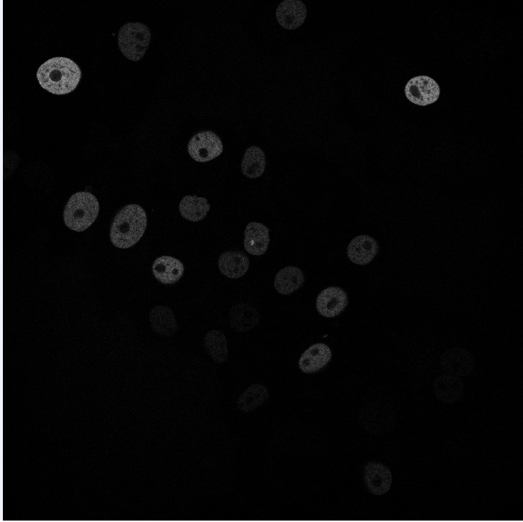
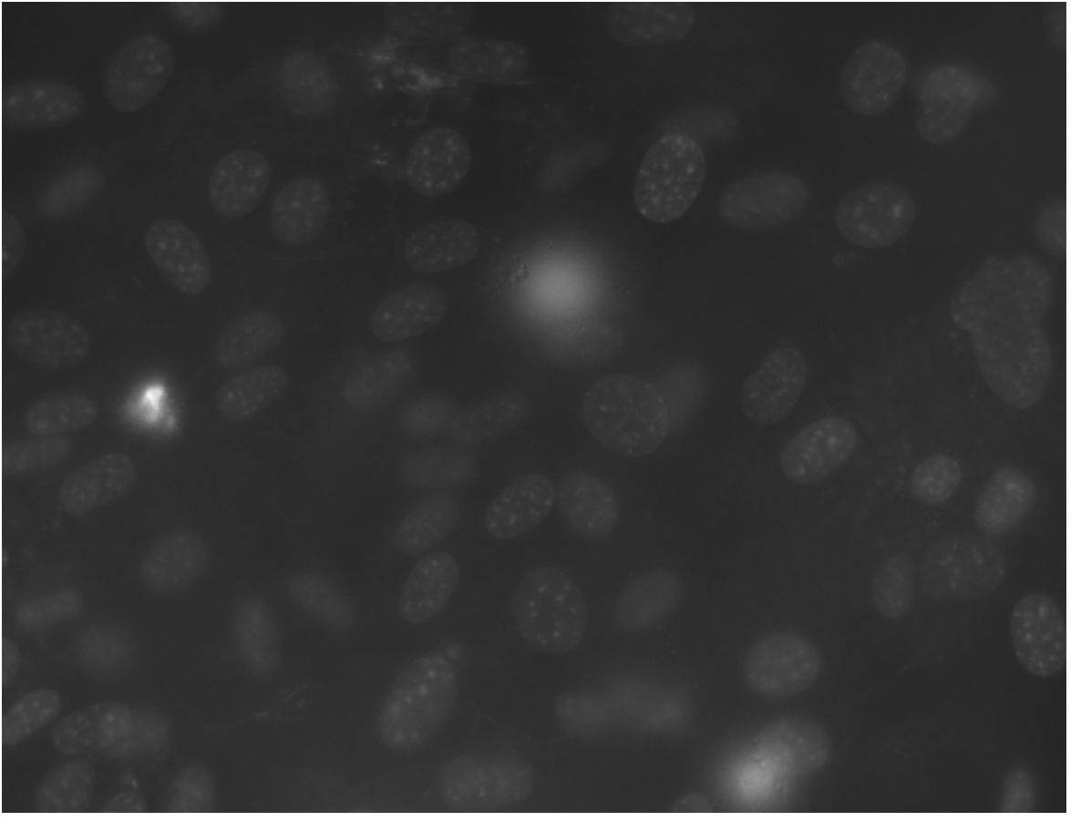
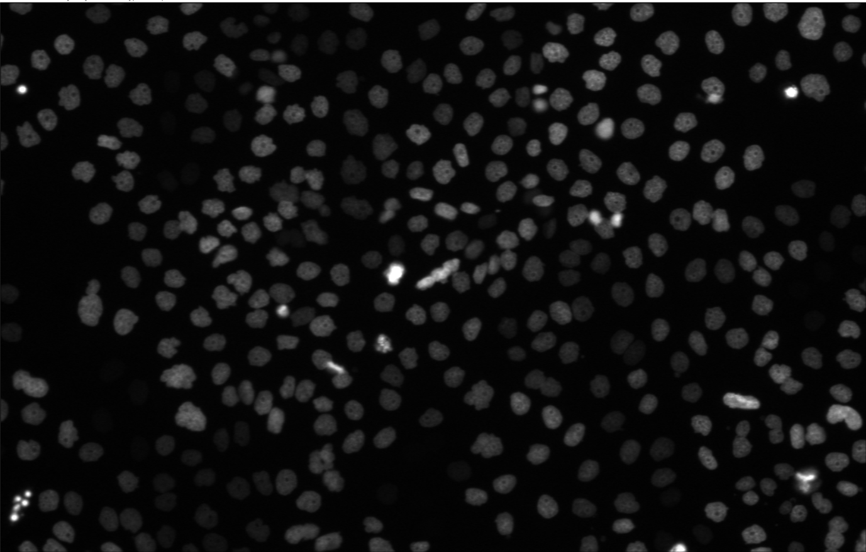


N2DL-HeLa (third dataset)
N2DH-GOWT1 (first dataset)
NIH3T3
(second dataset)
Noise
Low contrast
Holes
Brightness
Reflection
L: low resolution
N: nuclear
H: high resolution
2D: two-dimensional

Slide 6
Our Expectations
 | Challenge | Preprocessing method | Otsu variation
N2DH-GOWT1 | Noise Low contrast Holes | Filter Histogram stretching hole filling
NIH3T3 | Brightness Reflection | x | Multithresholding Local thresholding
N2DL-HeLa | …..
Solution Ideas Confirmed?

Slide 7
N2DH-GOWT1

Slide 8
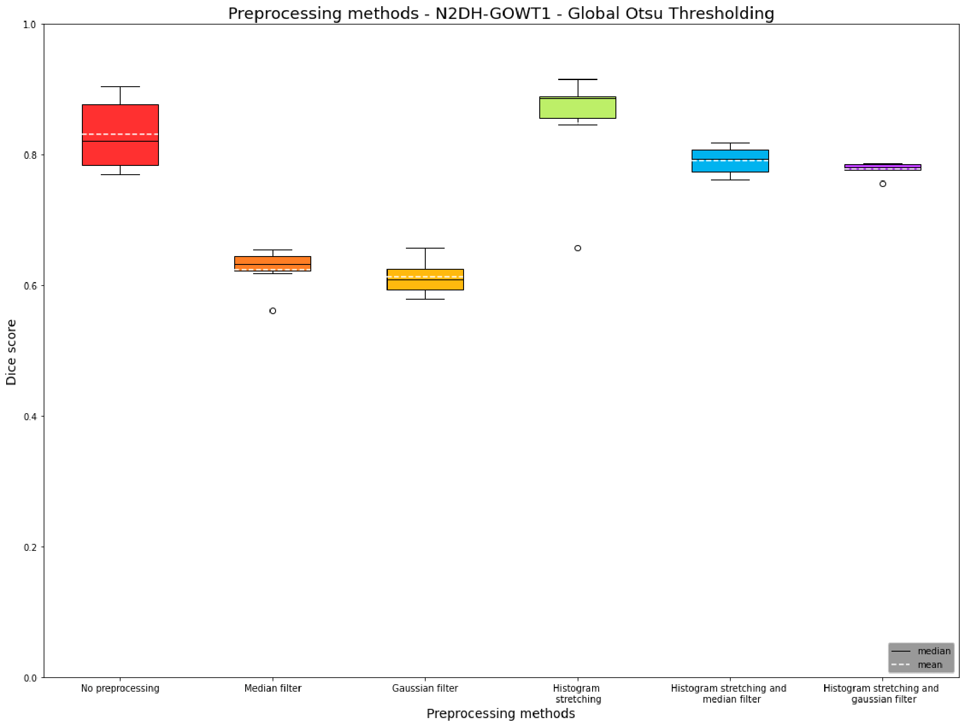
Boxplot Preprocessing Global Otsu

Slide 9
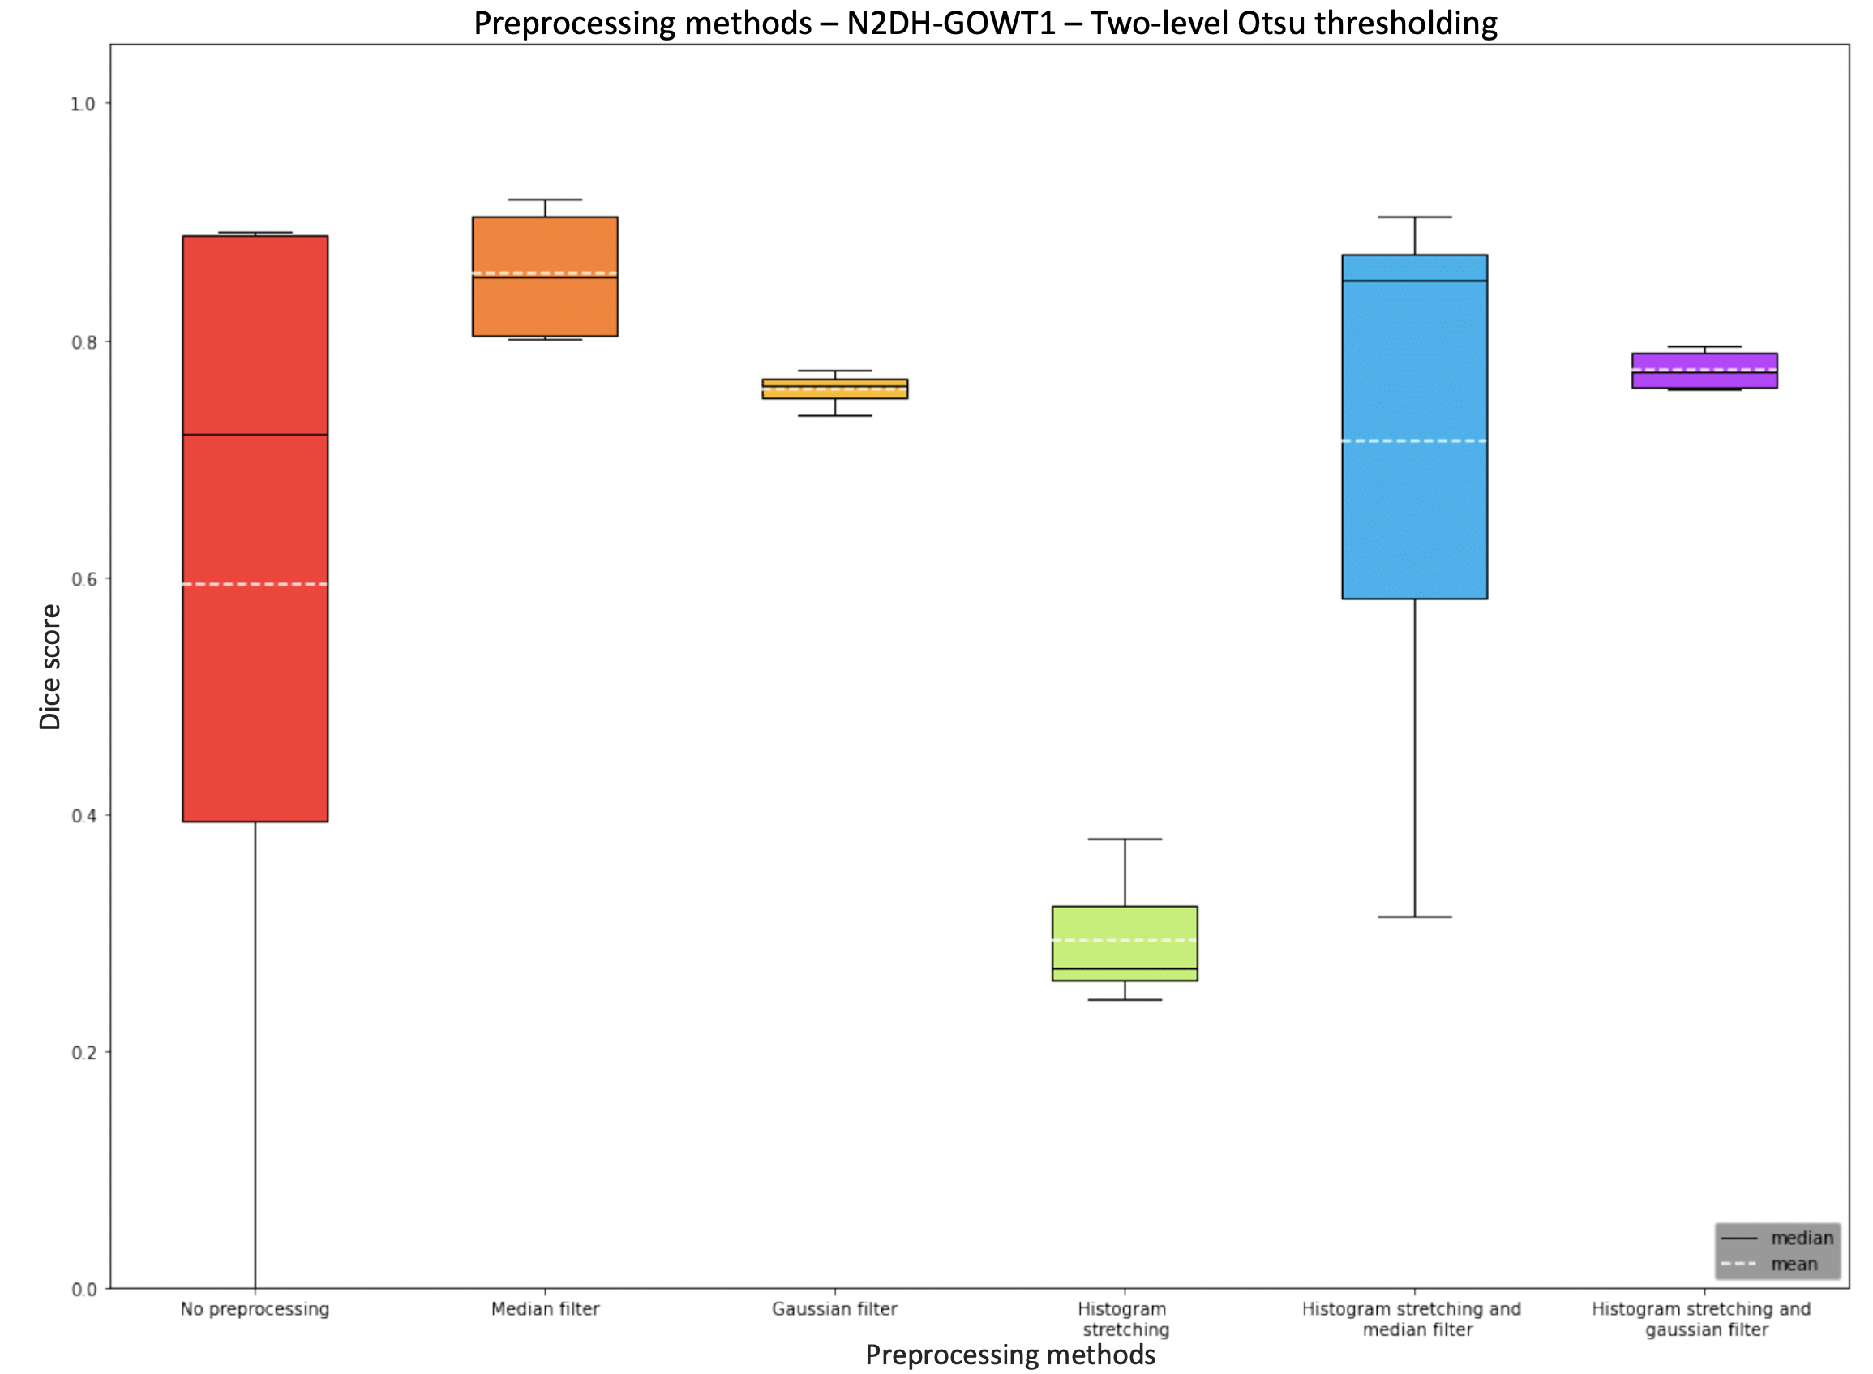
Boxplot Preprocessing two level Otsu

Slide 10
Boxplot Preprocessing- local adaptive
Not applied-> explain reason (discuss)

Slide 11
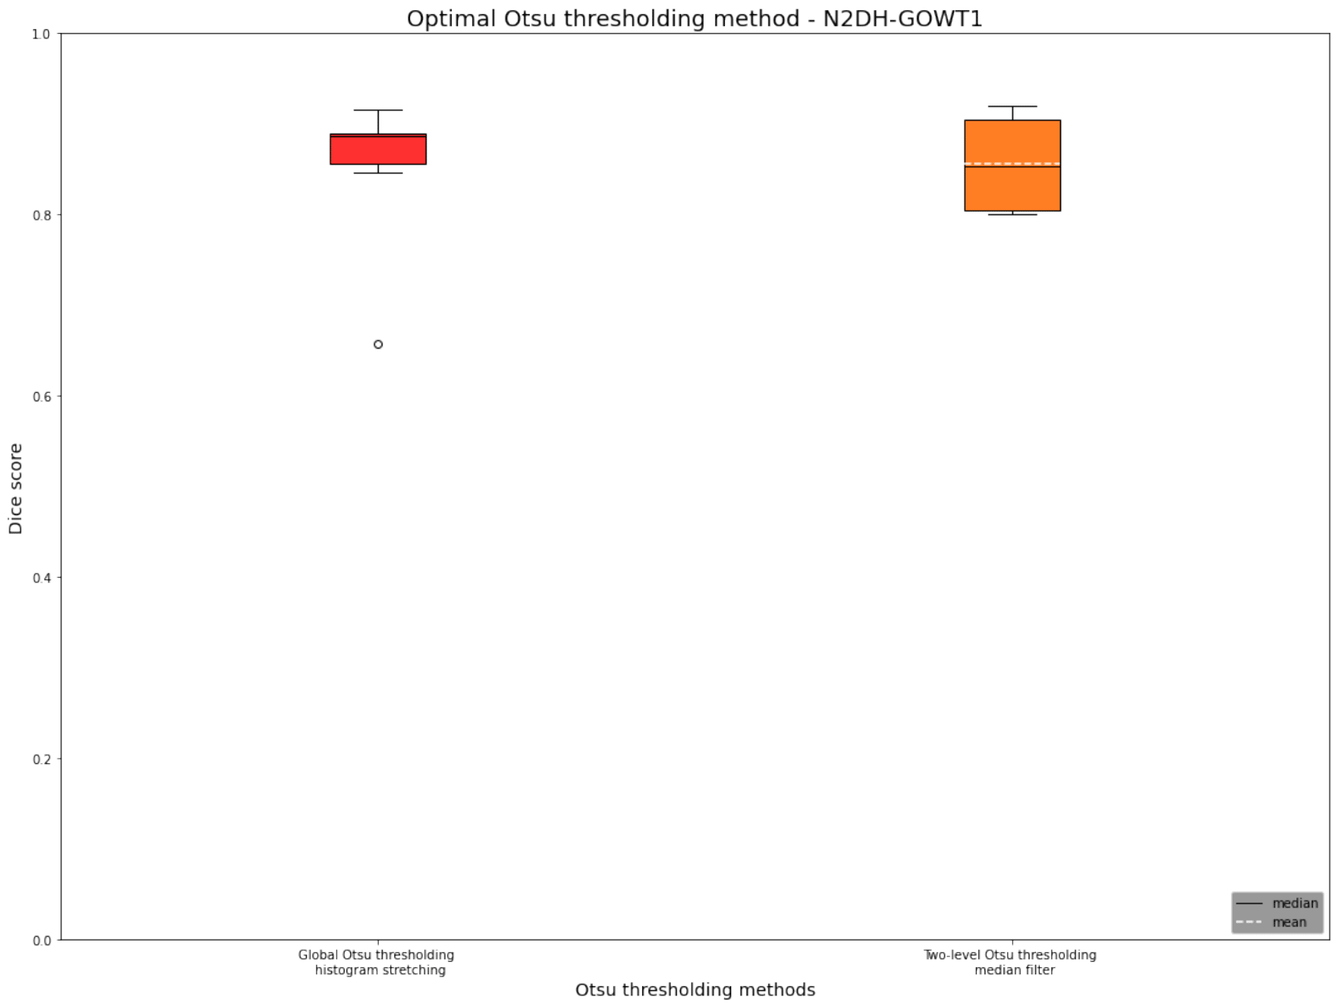
Boxplot optimal Otsu variation

Slide 12
„Final perfect recipe“
Diskussion beste ergebnis variante aufschreiben
Gloabl otsu and histogram stretching: 0.89

Slide 13
NIH3T3

Slide 14
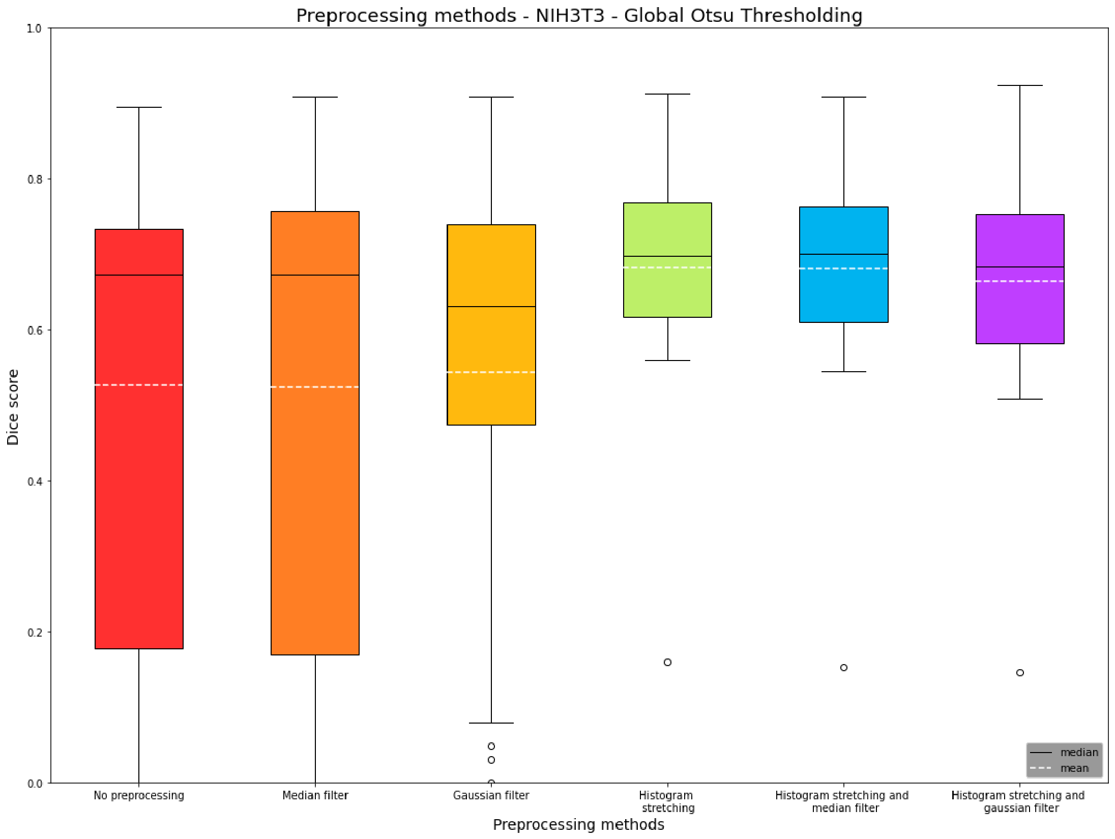
Boxplot Preprocessing Global otsu

Slide 15
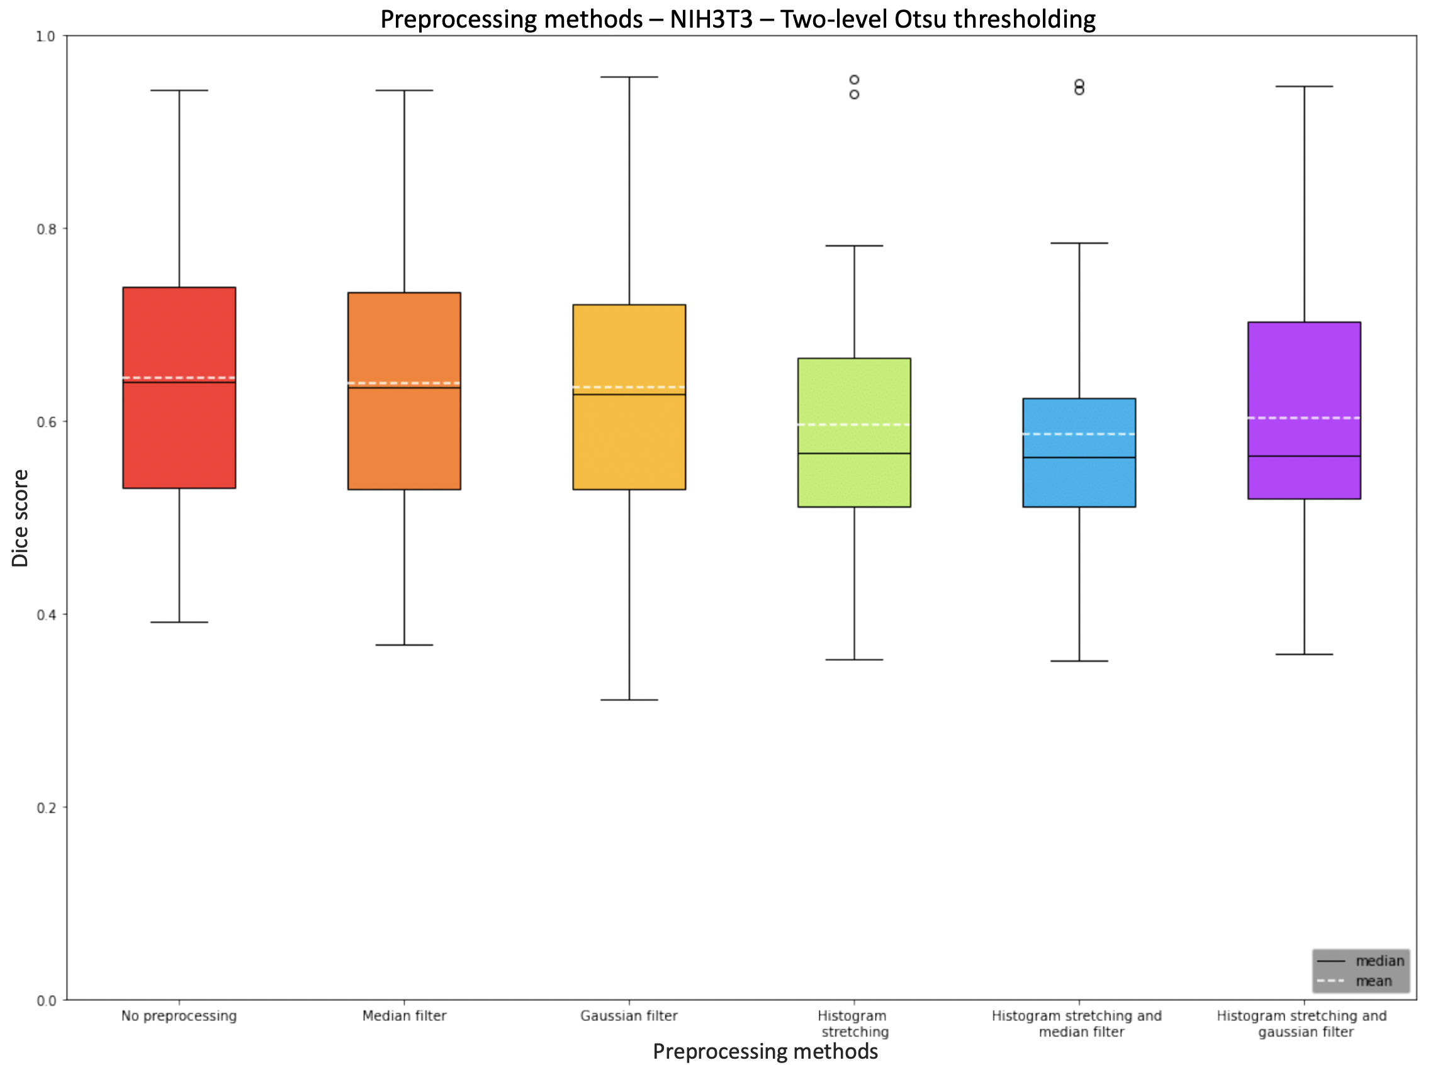
Boxplot Preprocessing two level Otsu

Slide 16
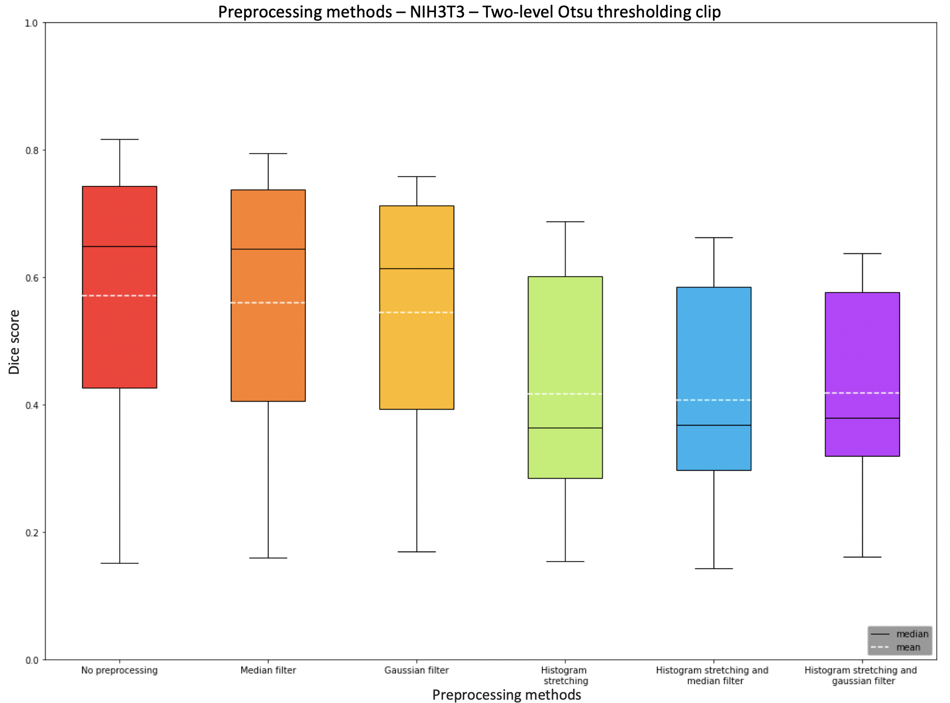
Boxplot Preprocessing two level Otsu clip

Slide 17
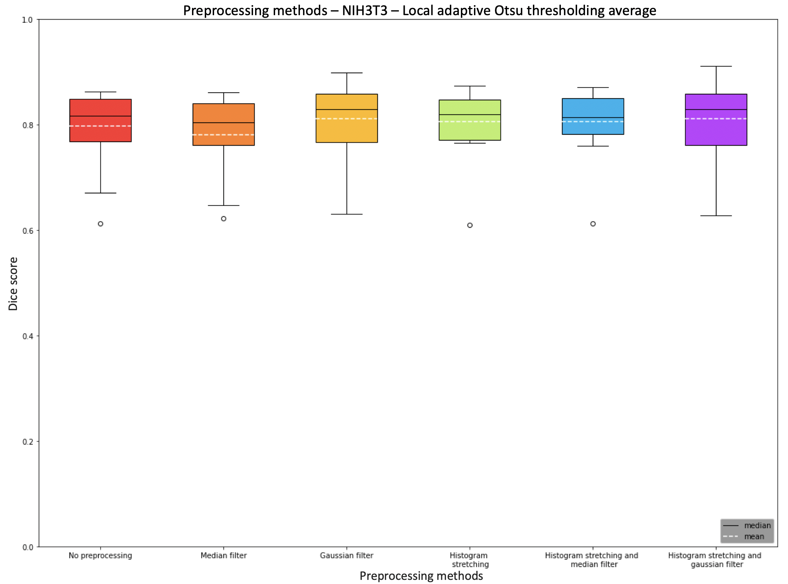
Boxplot Preprocessing local adaptive Otsu thresholding average

Slide 18
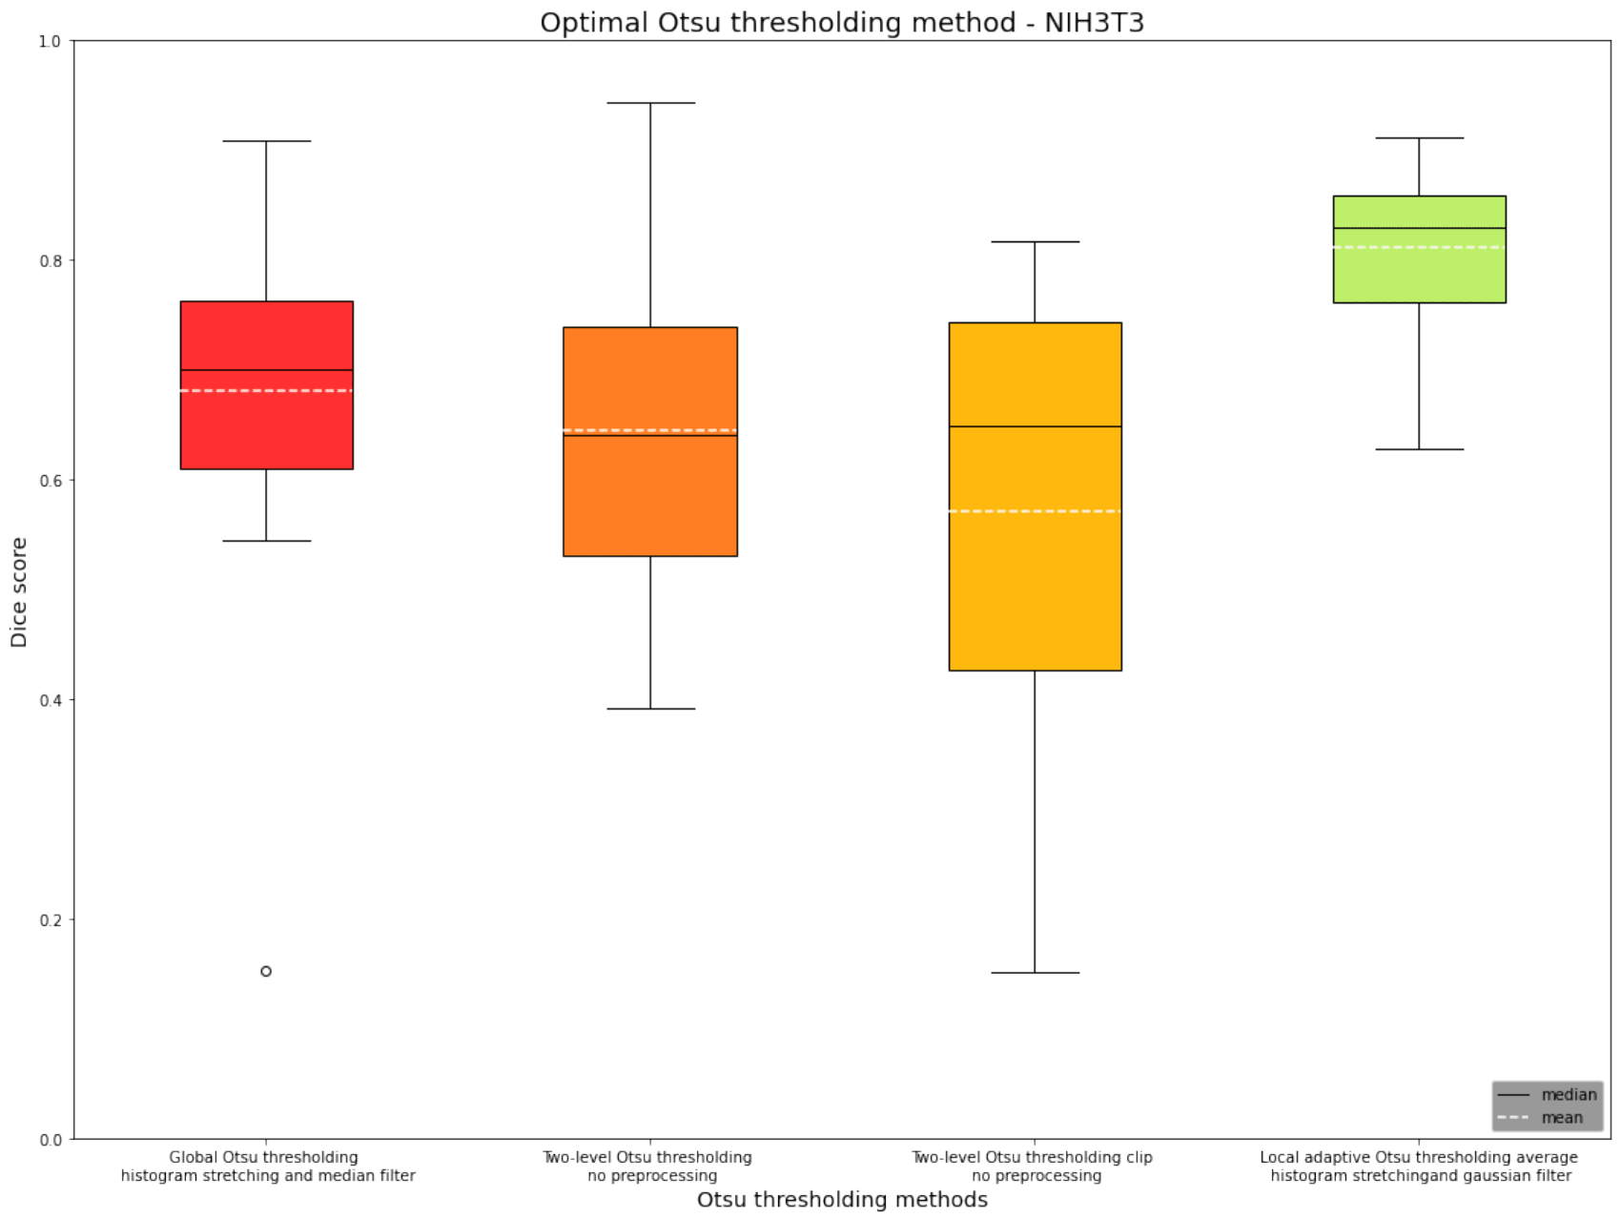
Boxplot optimal Otsus

Slide 19
The perfect recipe
Diskussion beste ergebnis variante aufschreiben
Local adaptive thresholding average and gaussian filter and histogram stretching: 0.83

Slide 20
N2DL-HeLa

Slide 21
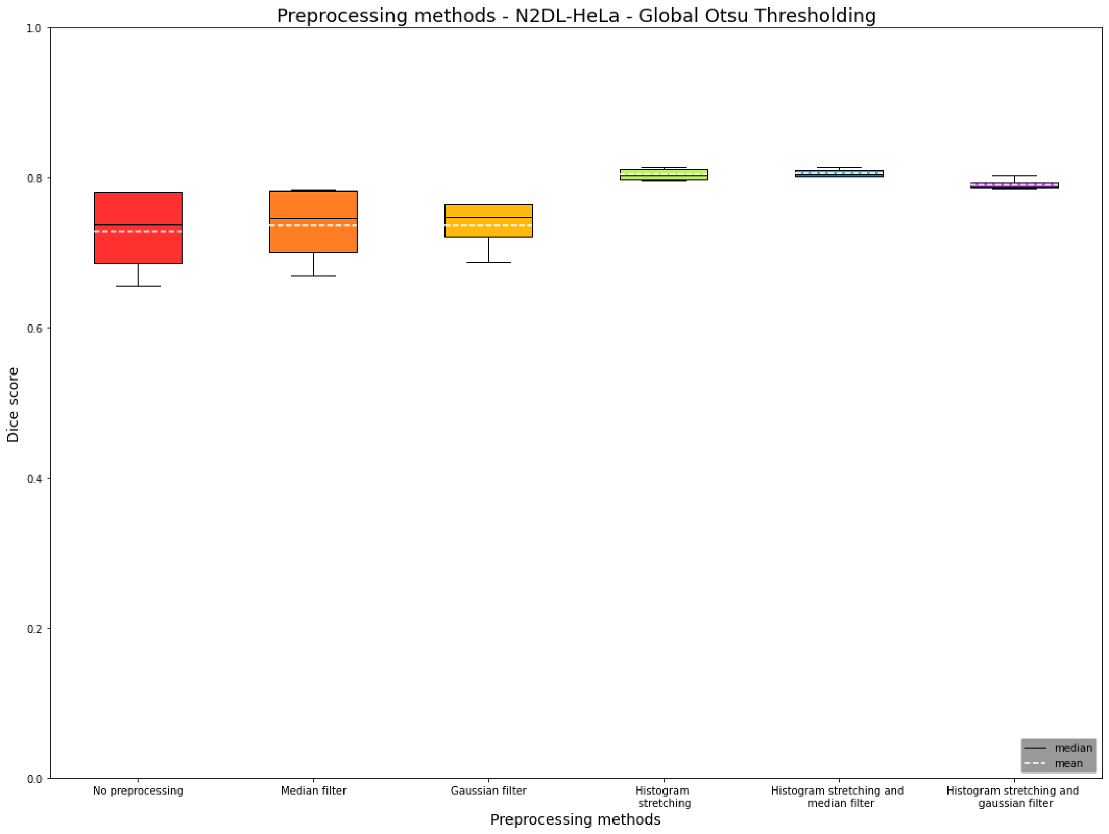
Boxplot Preprocessing Global Otsu

Slide 22
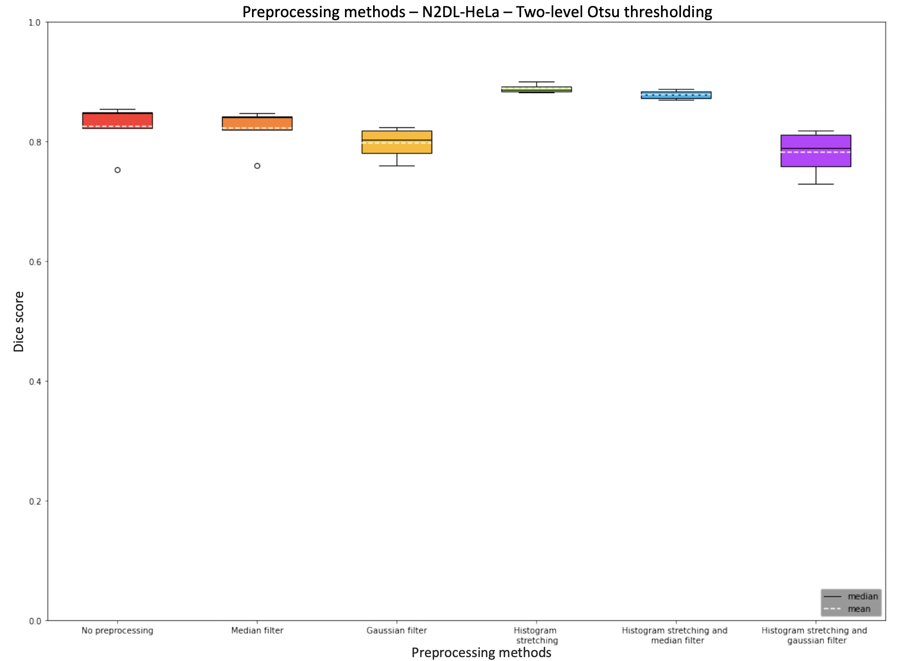
Boxplot Preprocessing two level otsu

Slide 23
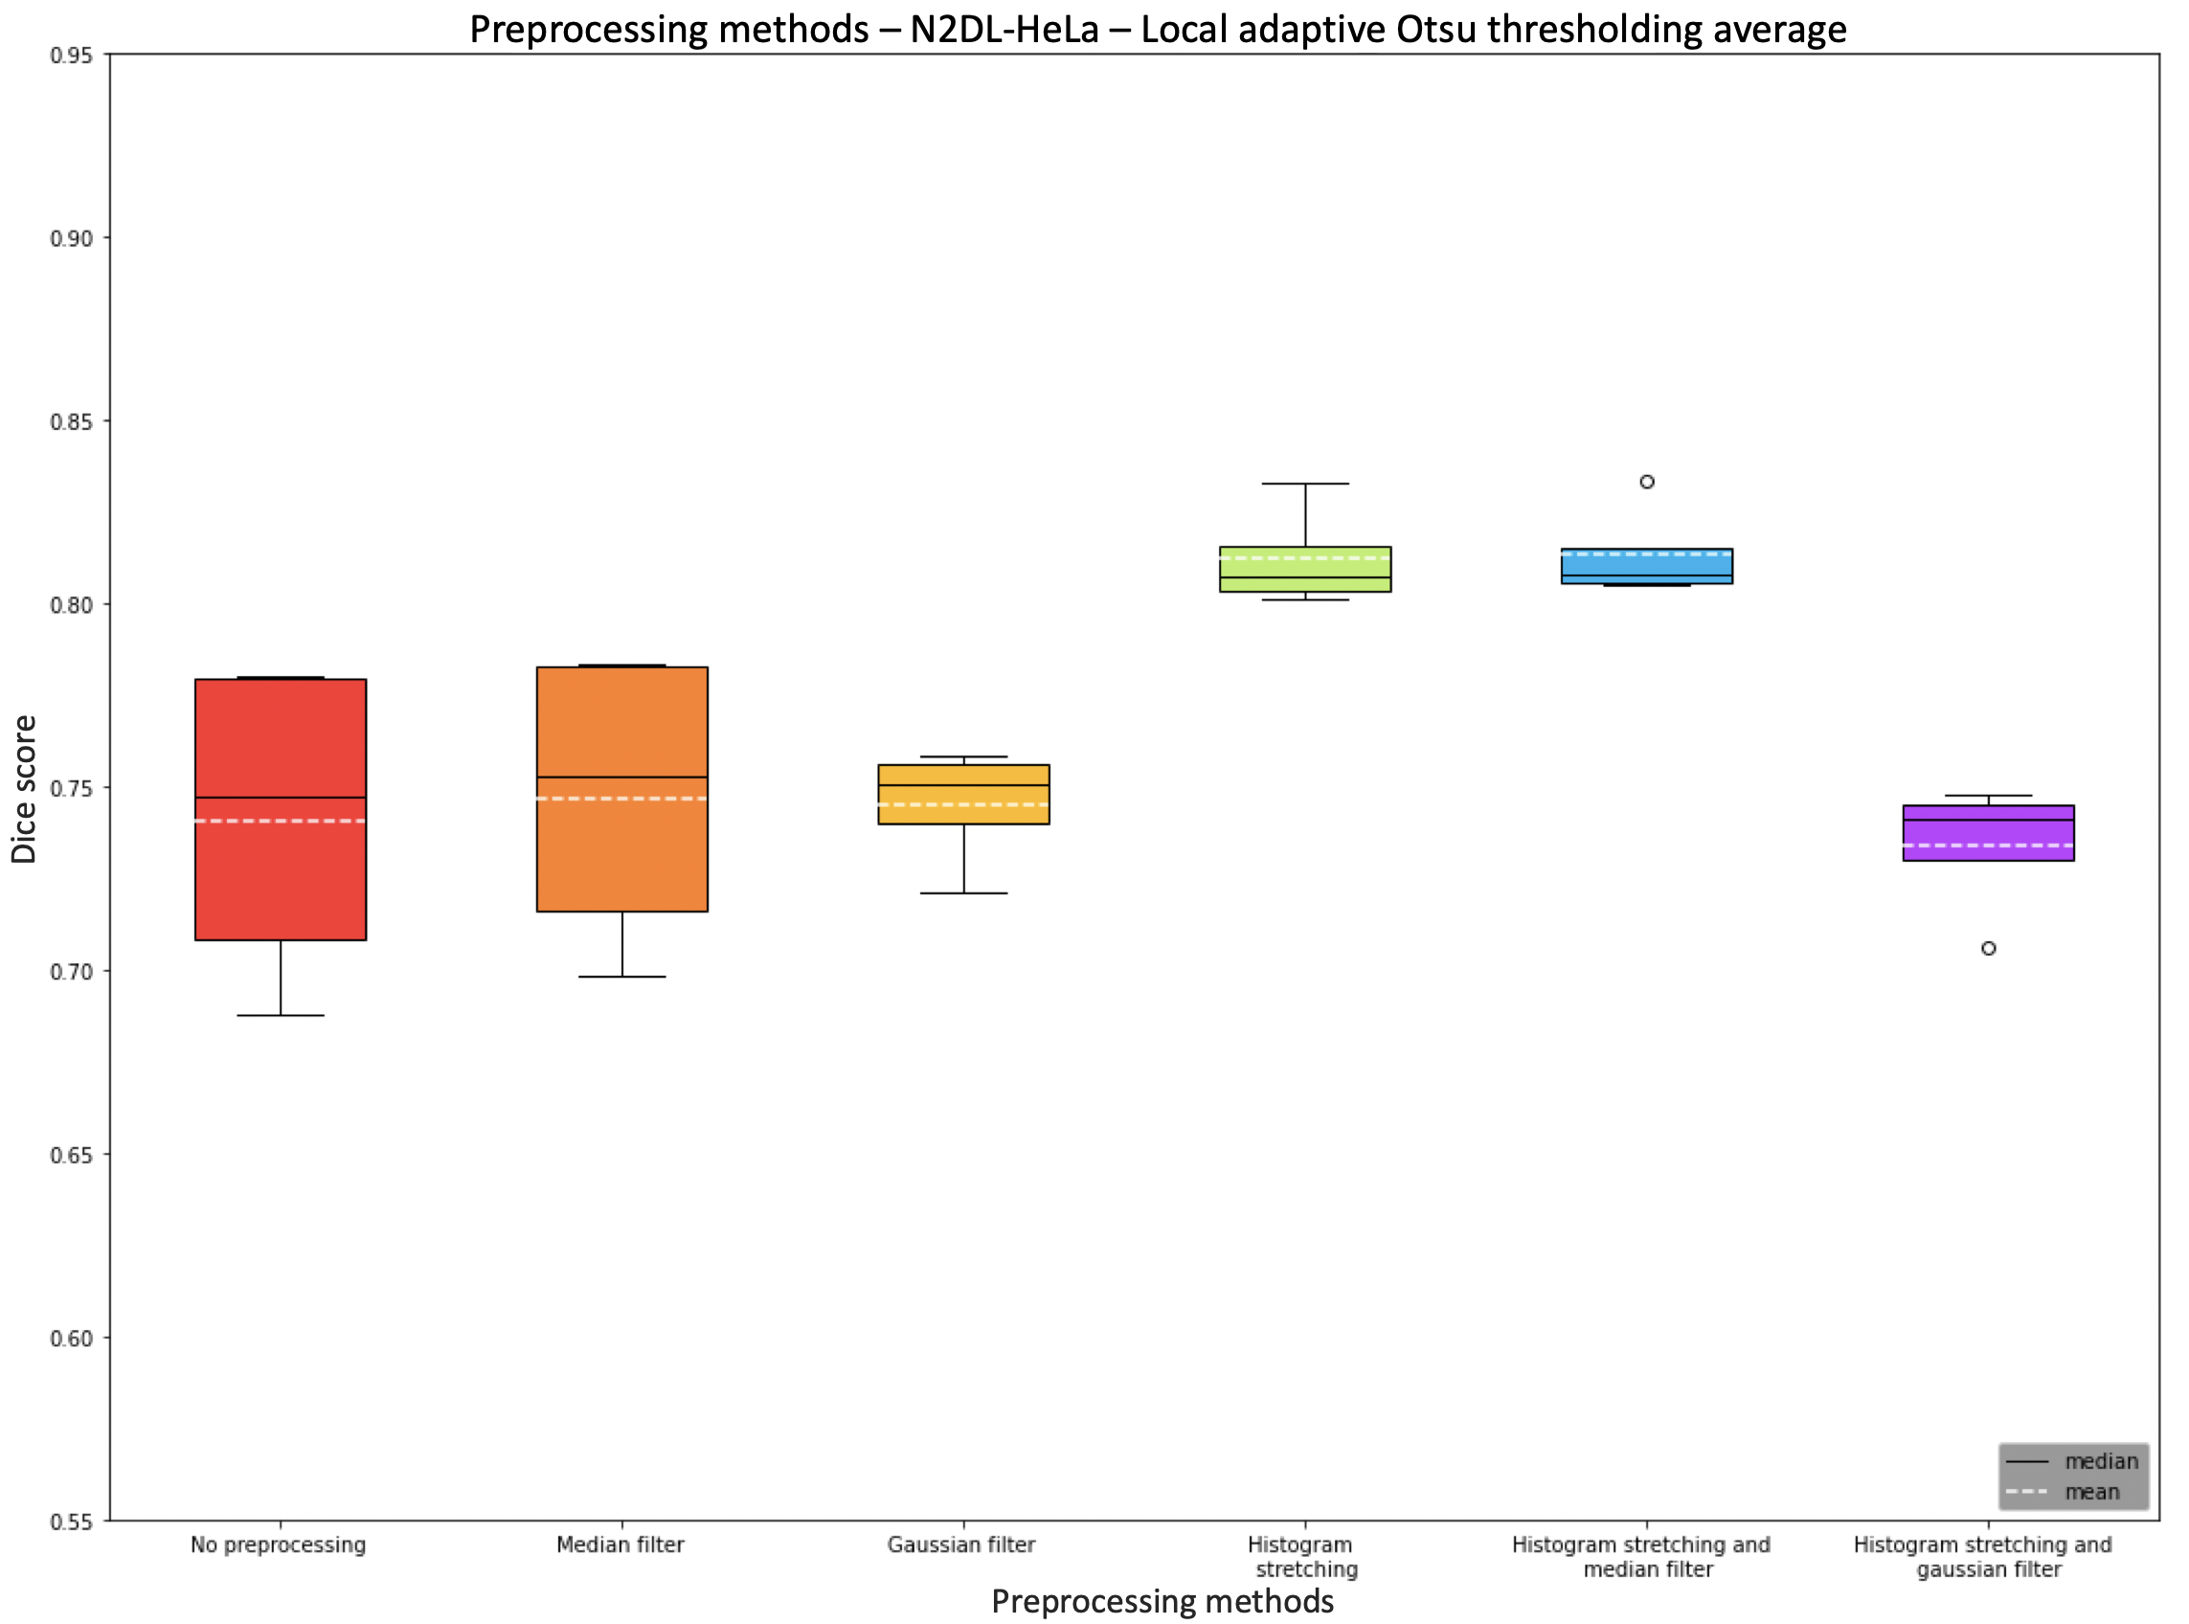
Boxplot Preprocessing- local adaptive Otsu

Slide 24
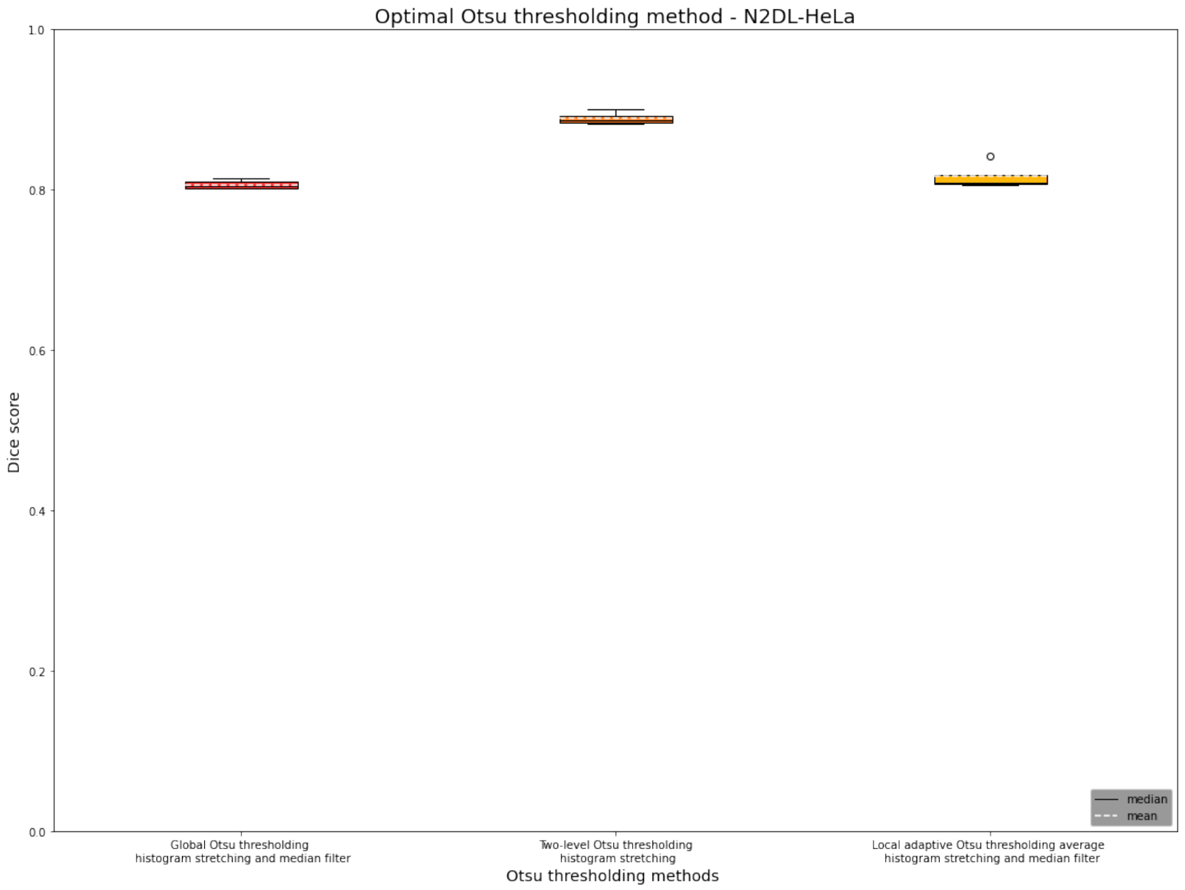
Boxplot optimal Otsu

Slide 25
The perfect recipe
Diskussion beste ergebnis variante aufschreiben
Two level Otsu and histogram stretching: 0.89

Slide 26
Solution ideas confirmed?

Slide 27
Solution Ideas Confirmed?!

Slide 28
 |  | Global Thresholding | Two Level Otsu | Two Level Otsu Clip | Local adaptive thresholding average
N2DH-GOWT1 | Preprocessing method | Histogram stretching | Median filter
 | Dice Score | 0.89 | 0.85
NIH3T3 | Preprocessing method | Histogram stretching and median | No preprocessing | No Preprocessing | Gaussian filter and histogram stretching
 | Dice Score | 0.70 | 0.64 | 0.65 | 0.83
N2DL-HeLa | Preprocessing method | Histogram stretching and median | Histogram stretching |  | Median filter and histogram stretching
 | Dice Score | 0.80 | 0.89 |  | 0.81

Slide 29
Challenges

Slide 30
Summary- the perfect recipe

Slide 31
N2DL-HeLa (third dataset)
Summary
N2DH-GOWT1 (first dataset)
NIH3T3
(second dataset)
Preprocessing:
Otsu:
Final Dice Score:
Preprocessing:
Otsu:
Final Dice Score:
Preprocessing:
Otsu:
Final Dice Score:
L: low resolution
N: nuclear
H: high resolution
2D: two-dimensional

Slide 32
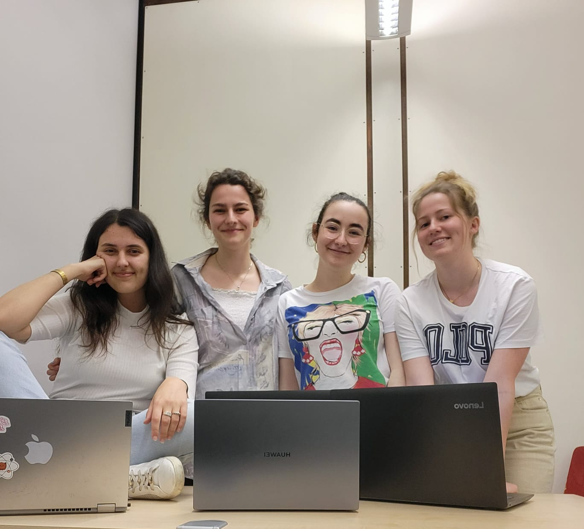
Thank you for your attention!

Slide 33

Extra slides

Slide 34
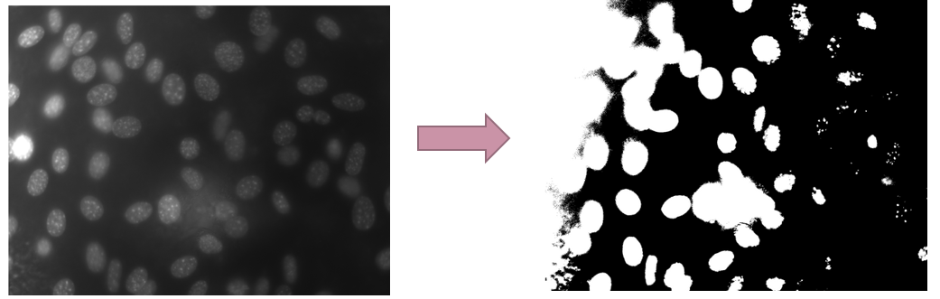
Why local thresholding?

Slide 35
Local thresholding vs local adaptive thresholing

Slide 36
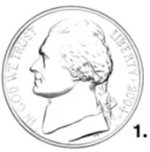
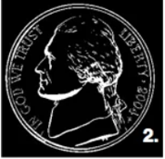
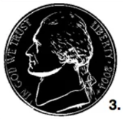
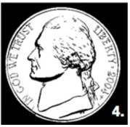
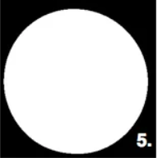
Hole filling

Slide 37
Cell counting
ideas:
Edge detection
clustering

Slide 38
Was hat es mit 0.00 dice scores auf sich

Slide 39
Difference filter first or stretching first

Slide 40
Solution Ideas
Challenge | Solution
Random noise | Gaussian filter, median filter
Holes | Median filter
Low contrast | Histogram stretching
Reflections | Intensity clipping, multithresholding
Brightness | Local thresholding

Slide 41
Challenges: N2DL-HeLa
Reflections

Slide 42
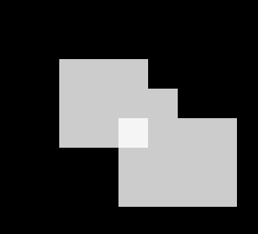


Dice score - Issues

Slide 43
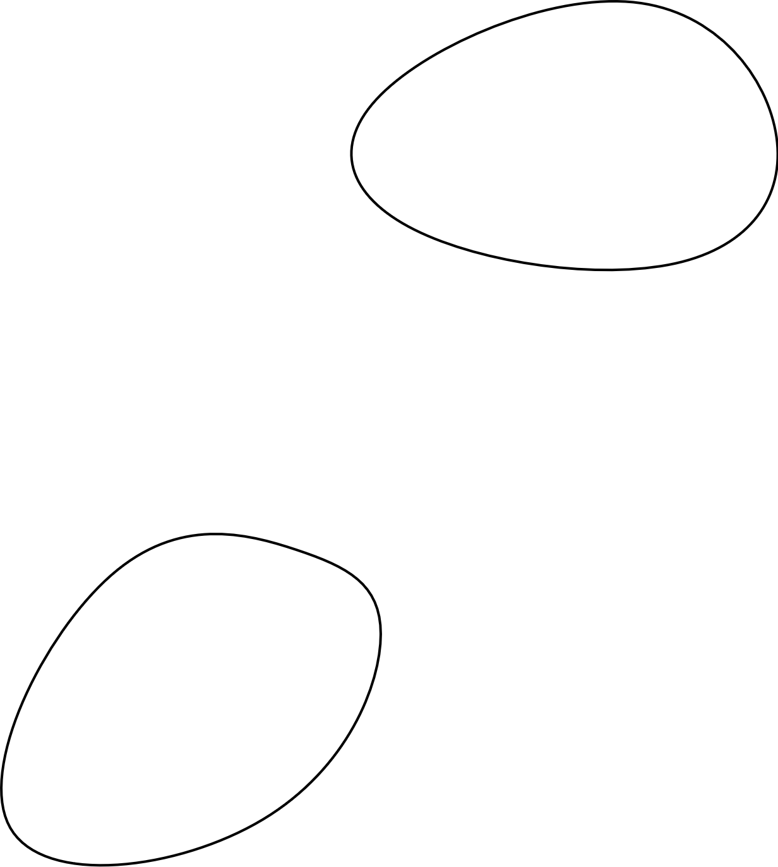
Evaluation algorithm – Dice score
~ 80% Accuracy

Slide 44

N2DH-GOWT1 Cell type: embryonic stem cells | Organism: Mouse (Mus musculus)
Express Oct4-GFP
Leica TGS SP5 (confocal microscope)
6 images total
1024x1024 pixels
10-20 nulei per image

Slide 45
NIH3T3 Cell type: Embryonic fibroblast cells | Organism: Mouse (Mus musculus)
Stained with Hoechst (fluorescent dye)
Fluorescence microscope
18 images total
Size: 1344x1024 pixels
about 60 nuclei per image

Slide 46

N2DL-HeLa Cell type: cervical adenocarcinoma cells | organism: human (Homo sapiens)
Express H2B-GFP
Olympus IX81 Confocal Microscope
4 images total
Size: 1100x 700 pixels
30-50 nuclei per image

Slide 47
Otus Thresholding usage
Locate cell boundaries
Cell type classification
Cell counting
Cell phenotype analysis (size, shape,..)
But not used for very complex images !

Slide 48
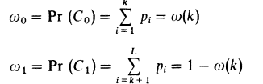
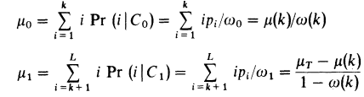
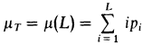
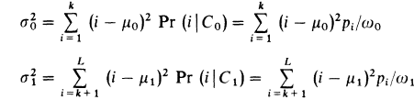
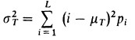
Otsu Thresholding
Class probabilities ($ω_{0,1}$):
Class mean levels ($μ_{0,1}$) and total mean level ($μ_{T}$):
Class variances ($σ_{0,1}^{2}$) and total variance ($σ_{T}^{2}$):
$L=$ Number of gray levels in the picture
$n_{i}=$ Number of pixels at level i
$N=$ Total number of pixels
$p_{i}=$ Probability of level i
$k=$ Threshold intensity
$$p_{i}= n_{i}/N$$
Otsu, N. "A threshold selection method from gray-level histograms." IEEE Transactions on Systems, Man, and Cybernetics 9:1 (1979), pp 62-66.

Slide 49
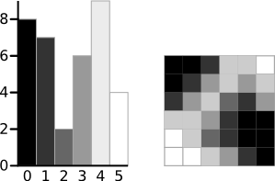
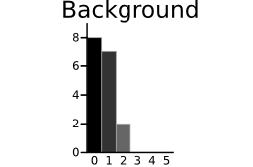
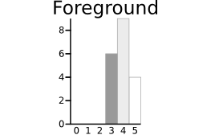
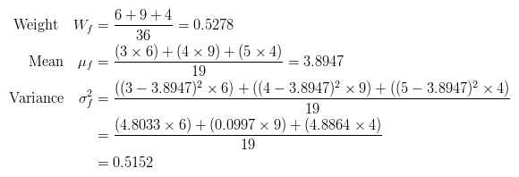
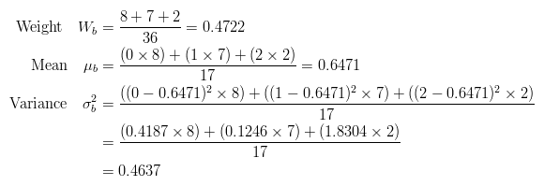
Otsu Thresholding
http://www.labbookpages.co.uk/software/imgProc/otsuThreshold.html

Slide 50
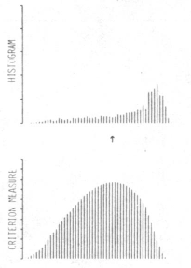
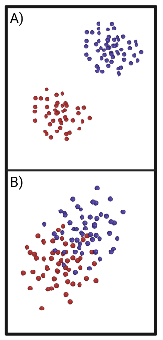

Discriminant Criterion Measure
Criterion measure
$η\left(T\right)=σ_{B}^{2}\left(T\right)/$ $σ_{T}^{2}$
$σ_{B}^{2}$= Between-class variance
$σ_{T}^{2}$ = Total variance
$0≤η^{∗}≤1$
Otsu, N. "A threshold selection method from gray-level histograms." IEEE Transactions on Systems, Man, and Cybernetics 9:1 (1979), pp 62-66.

Slide 51
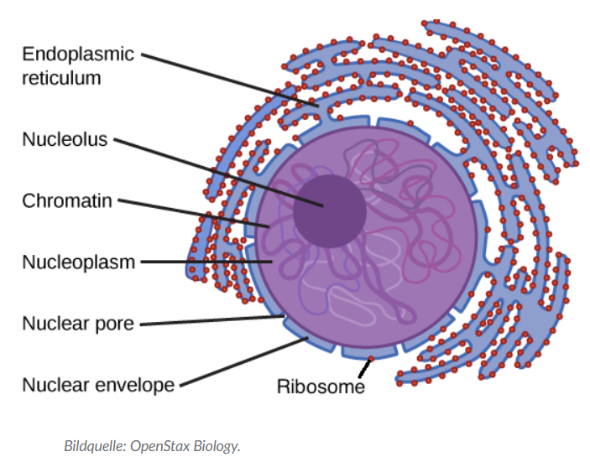
Holes

Slide 52
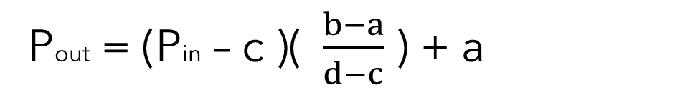
Histogram stretching
stretching range of intensity values to achieve a higher contrast -> linear scaling
Pout = (Pin – c )($\frac{b−a}{d−c}$ ) + a
https://homepages.inf.ed.ac.uk/rbf/HIPR2/stretch.htm

Slide 53
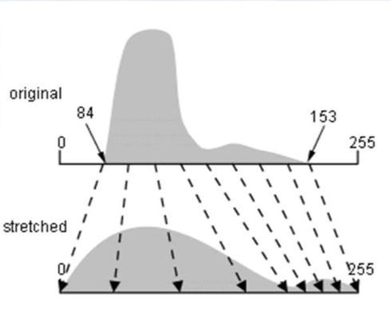
Example Histogram stretching
https://i.stack.imgur.com/9gIw6.png

Slide 54
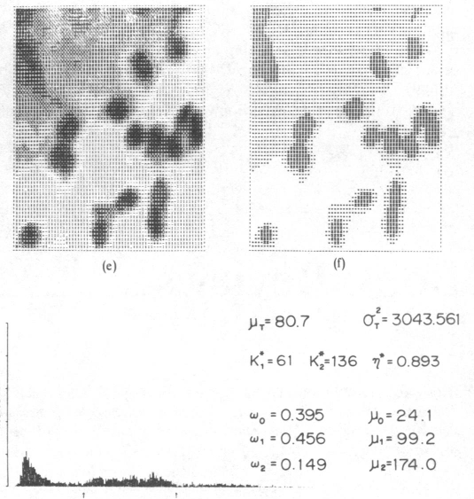

Two-level Otsu Thresholding
Two-level Otsu Thresholding
$σ_{B}^{2}=ω_{1}\left(μ_{1}−μ_{T}\right)2−$ $ω_{2}\left(μ_{2}−μ_{T}\right)2−$ $ω_{3}\left(μ_{3}−μ_{T}\right)2$
$ω_{1,2,3}$ = Probabilities of class occurrence
$μ_{1,2,3}$ = Class mean levels
$μ_{T}$ = Total mean level
Otsu, N. "A threshold selection method from gray-level histograms." IEEE Transactions on Systems, Man, and Cybernetics 9:1 (1979), pp 62-66.

Slide 55
Application of Filter
Choose Filtermask
Convolution
Flipping filter
Multiplication of filter values with image intensity values
Summation of the multiplication results

Slide 56
Cell counting
Why?
Monitor health of the cells
Proliferation rate
How?
Edge detection

Slide 57
Other threshold methods | Other segmentation methods
Kittler´s thresholding | K-means
Kapur´s thresholding | Watershed
Tsai´s thresholding | Graph cuts

